Slide 1
Shipboard power system limiting load flow and load flow analysis
Dr. Norbert Doerry
NSWC Carderock
ESTS 2025
Alexandria VA
August 2025

Slide 2
Load Flow Analysis in Shipboard Power Systems
Purpose
  Determine the potential for overloading cables and other distribution system equipment
  Possibly support Voltage Drop calculations
Traditional Load Flow Analysis
  Calculate voltages and currents at all points in the system for all configurations and operating conditions
  Use worst case current flow to determine adequacy of cable and distribution system equipment current rating
Differences between shipboard systems and terrestrial systems that
impact load flow analysis
  Load Sharing vice Power Scheduling
  Short Electrical Distances
  Greater Centralized Control
Identifying the worst case (highest current) condition for a given cable or distribution system equipment may be challenging
  Different configurations of online generators
  Different configurations of online loads
  Electric Power Load Analysis (EPLA) may be immature
    Detailed information may not be available
  Ring buses, mesh topologies, and zonal systems are especially challenging

Slide 3
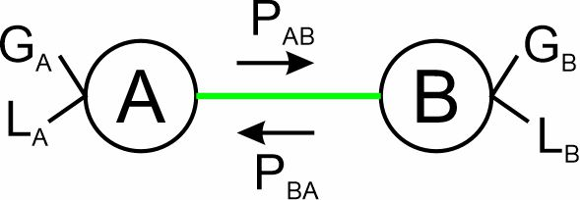
Limiting Load Flow (Cables)
During early stages of design, do not have sufficient information to conduct a detailed load flow analysis.
Can, however, estimate an upper bound of current (power) flow.
In any cable segment the power flow through a cable in one direction is limited by the lower of the total generation capacity on one end of the cable and of the total load on the other end of the cable. (Capacity can be current or power)
Limiting Load Flow estimates
  Most Conservative: Ignore loads – Sum the capacity of all online generation connected to the cable.
  Less Conservative: Ignore loads – compare generation capacity on each end of cable and use the larger.
  Least Conservative: Compare the loads connected on one end of the cable and compare to generation on the other end, use the smaller as the limiting load flow in that direction. Use the larger of the limiting load flows of the two directions.

Slide 4
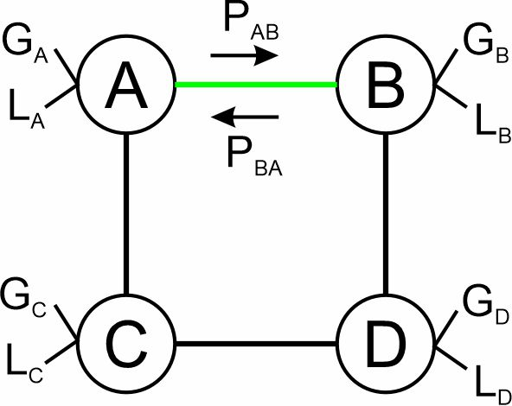
Limiting Load Flow nuances (Cables)
Loads that may be switched via a bus transfer to either end of the cable should be counted on both ends of the cable.
Loads should have margins and service life allowance applied
Multi-path networks (where the two ends of the cable are connected within the network) require special treatment.
  Must calculate limiting load flow for all possible cases where sufficient other cables are removed to eliminate the connection between the two ends of the cable – use the worst case.
Program for calculating limiting load flow for cables is available
  http://doerry.org/norbert/MarineElectricalPowerSystems/Software/C_LLF/

Slide 5
Load Flow (Cables and Switchboards)
Load Flow Analysis is appropriate once the EPLA is mature and system concepts of operation (CONOPS) exist.
  Generator set scheduling table
  Propulsion motor scheduling table (for Integrated Power Systems (IPS))
Typically employs a steady-state modeling and simulation tool such as S3D to find the worst case current (power) flow.
  If the power distribution system incorporates a multi-path network, then details of the cable impedance of the bus ties are needed to accurately estimate power flows.
  Worst case power flow often occurs where there is a lot of asymmetry of loads and sources on the ends of the cable (or switchboard connections)

Slide 6
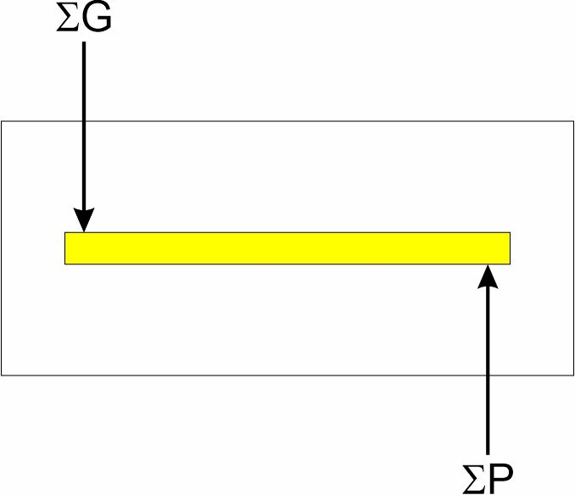
Limiting Load Flow (Switchboards)
Goal: Determine maximum current flow in the bus bars of the switchboards
Assume
  All Generation connections are on one end of the bus bar
  All Load connections are on the other end of the bus bar
Limiting Load Flow
  Most Conservative: Ignore loads – Sum the capacity of all online generation connected to the switchboard.
  Least Conservative: Compare the loads connected to the switchboard and compare to generation connected to the switchboard. Use the smaller of the total generation and total load.

Slide 7
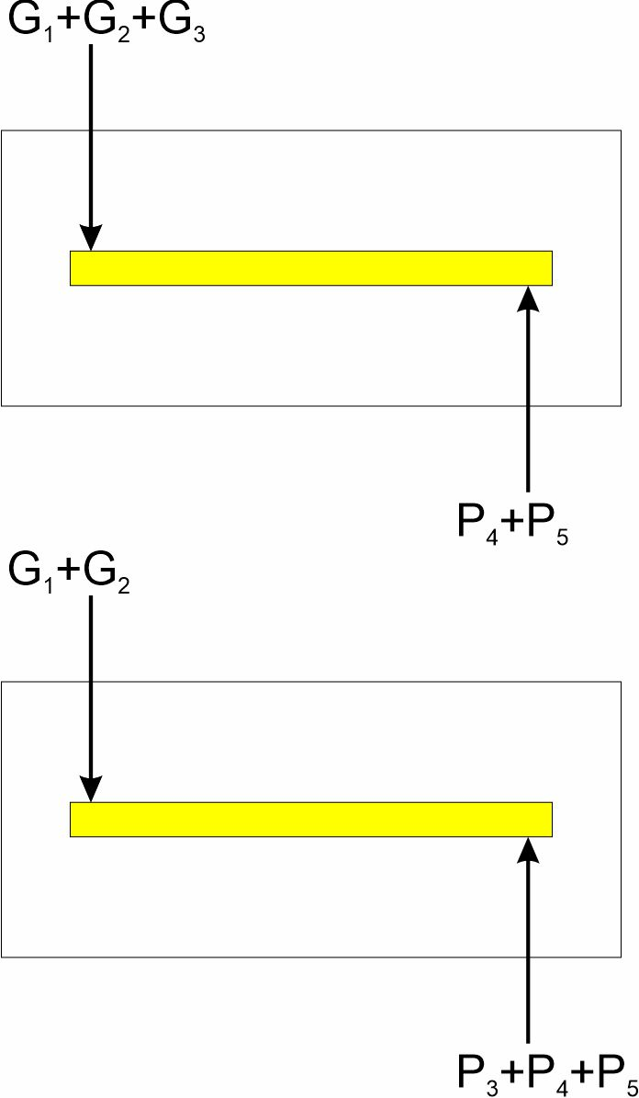
Limiting Load Flow nuances (Switchboards)
Some connections have both sources and loads on the same interface.
  For the set of connections that have both sources and loads, need to check for all combinations where one considers separately the connection to be generation or load.
Loads should have margins and service life allowance applied
Multi-path networks (where two connections to the switchboard are connected outside of the switchboard).
  Must calculate limiting load flow for all possible cases where sufficient other cables are removed to eliminate the external connection between the switchboard connections – use the worst case.

Slide 8
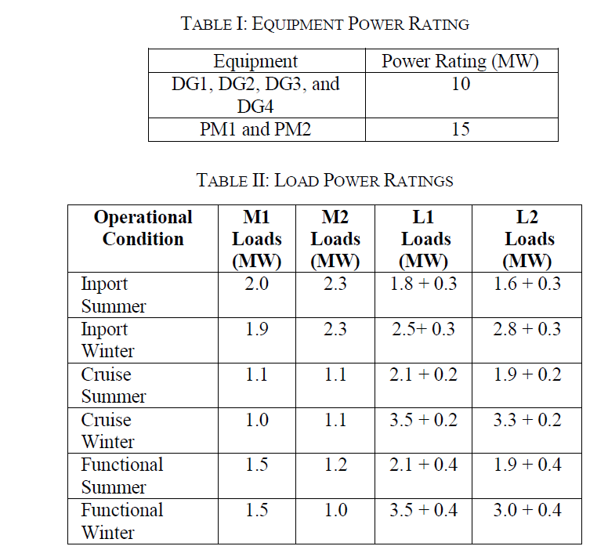
Limiting Load Flow Example

Slide 9
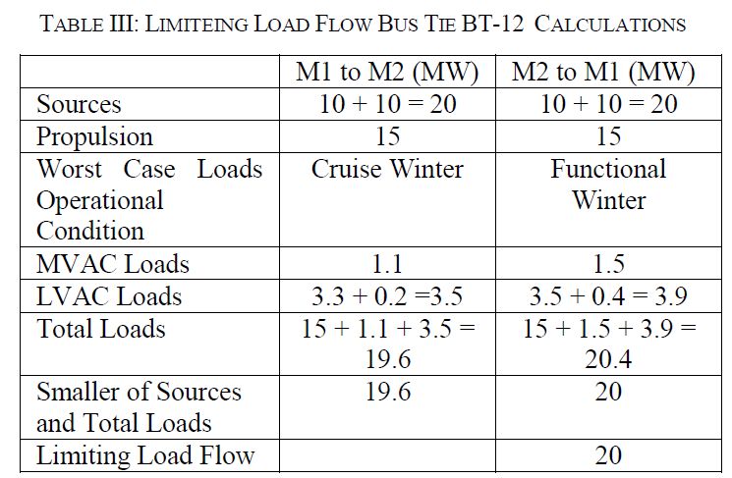
Limiting Load Flow Example (BT-12)
  Most Conservative: Ignore loads – Sum the capacity of all online generation connected to the cable.
    4 x 10 MW = 40 MW
  Less Conservative: Ignore loads – compare generation capacity on each end of cable and use the larger.
    2 x 10 MW = 20 MW
  Least Conservative: Compare the loads connected on one end of the cable and compare to generation on the other end, use the smaller as the limiting load flow in that direction. Use the larger of the limiting load flows of the two directions.
  Compare to Load Flow Analysis for 24 different simulations
    Maximum power flow of 16 MW

Slide 10
Summary
Limiting Load Flow method useful in early stages of design when sufficient detail for a detailed load flow analysis does not exist.
Load Flow method useful in later stages of design when sufficient detail about the power system, loads, and concepts of operation exist.

